Slide 1
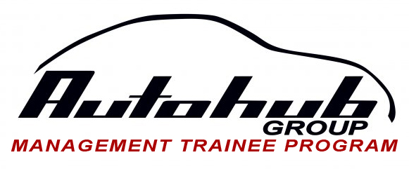
IT GROUP
Trainee: Jeffrey Cagampang
Learning Coach: Sir Arnel Endaya

Slide 2
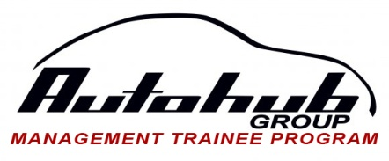
IT GROUP
GOALS AND OBJECTIVES
Provide IT Support and Services
Technology Modernization
Computerization and Automation
Reduce IT OPEX

Slide 3
IT GROUP
COMPONENTS
Technical Support
First level of support
Day to day concerns of users whether systems, network, and/or server
Requires basic knowledge in IT
Systems and Application Support
System specific knowledge (INCADIA, DMIS, DMS)
Network Support
Security of network issues, equipments, transaction
Server Administration and Support
Both system and hardware regardless the server (ex. web server, file server, database server

Slide 4
IT GROUP
ROLES AND FUNCTIONS
Provide Technical Support
Maintain and Administer IT Services
Network and Security Administration
Technology Update and Modernization

Slide 5
IT GROUP
PLANNING
Network Design | Topology Point to Point Point to Multipoint
 | What type of processes? How many current users? How many projected users?
Server | Software and hardware specifications
Storage | Cloud / SAN and specifications
Data Security | Types of services to secure
Support | Number of manpower for support Including salary costing Specialized employee?
Budget | Over-all cost

Slide 6
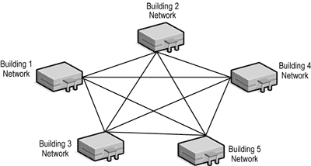
IT GROUP
MESH TOPOLOGY
HOST
Internet – Site connectivity and browsing
Lease lines – Data connectivity
Point to multipoint accessibility
REMOTE
REMOTE
REMOTE
REMOTE
Advantage | Disadvantage
High availability Network link | Wide broadcast Slow network

Slide 7
IT GROUP
NETWORK SET UP
Within the site
(Host or remote)
DSL
IGATE
VP ROUTER – Connection of host site and remote site
FIREWALL – Security
CORE SWITCH
DISTRIBUTION SWITCH
SERVER
HARDWARE
POWER BACK UPS

Slide 8
IT GROUP
SERVER ADMINISTRATION (Services)
Domain Controller – Manages accounts/users. The access granted to the account
File Server – Manages storage per department. Communicates with domain controller on what files it should manage
Mail Server – Monitoring of emails. Processed and rejected
Database Server – Database monitoring and administration
Application – Does not run without the database. Ex. HRIS Helpdesk, website hosting
Back Up System – Manual backup performed daily
Disaster Recovery – Forces of nature
Telephone System – Local area landlines.
Not employed in Autohub

Slide 9
IT GROUP
STORAGE
Virtual Storage – Application which enable to expand the storage virtually while utilizing less physical storage
VM1
VM2
STORAGE 1
For SQL
VS
SQL
Web
File
Set as back up
Up when VM1 fails
STORAGE 2
For Web
STORAGE
STORAGE 3
For File
Single hardware

Slide 10
IT GROUP
NETWORK MONITORING
Network admin – Specialized in monitoring and analyzing data from security/firewall
Web Monitoring – What sites? Duration of access? User?
Security Monitoring – Hackers and viruses
Web Filtering – What can an account/user access?
Network Utilization – Capacity of usage
Live Monitoring – Real time monitoring
MONITORING TO ADDRESS/AVOID THREATS – VIRUSES AND HACKERS, as well as NETWORK and SYSTEM FAILURE

Slide 11
IT GROUP
IT SUPPORT
S
Requestor
Helpdesk
Department Admin
Ticket Handler
F
Requestor Update
Ticket Closing
Ticket Processing
Since the helpdesk is not running yet, the process are as follows
Requestor
IT support
Processing the problem
Manual logging in of the issue

Slide 12
IT GROUP
COMMENTS AND RECOMMENDATIONS
Monitoring Specialist
At least one (1) personnel dedicated for monitoring (server, storage, networks etc.)
Increase in OPEX
Maintain old system
Salary of additional employee is lesser than the expense when the system fails

Slide 13
IT GROUP
COMMENTS AND RECOMMENDATIONS
Data Center Facility Upgrade
IT solutions/professionals
Increase CAPEX; reduce OPEX (long run)
Expansion – Users/software and hardware specifications
Provide proper data center and infrastructure management; automatic back up; disaster and recovery

Slide 14
IT GROUP
Trainee: Jeffrey Cagampang
Learning Coach: Sir Arnel Endaya

